Slide 1
Chapter 4
A Tour of the Cell

Slide 2
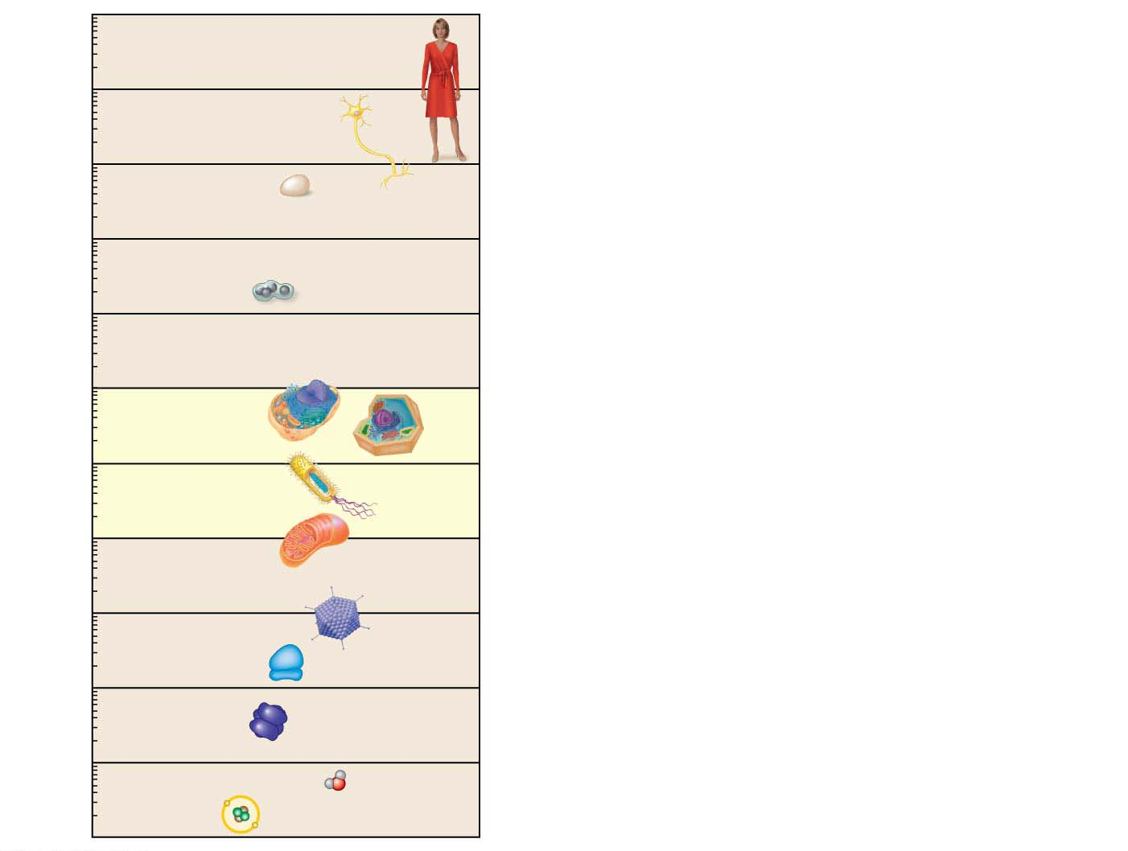
Figure 4.1
10 m
1 m
Human height
Length of some
nerve and muscle
cells
10 cm
Chicken egg
Visible with
the naked eye
1 cm
Frog eggs
1 mm
100 μm
Plant and
animal cells
10 μm
Nuclei
Most bacteria
1 μm
Mitochondria
Measurement Equivalents
Smallest
bacteria
1 meter (m) = 100 cm = 1,000 mm = about 39.4 inches
100 nm
Viruses
1 centimeter (cm) = 10⁻²
1
m = about 0.4 inch
Ribosomes
100
10 nm
1
1
Proteins
1 millimeter (mm) = 10⁻³
1,000
m =
10
cm
Lipids
1 nm
Small molecules
1 micrometer (μm) = 10⁻⁶ m = 10⁻³ mm
0.1 nm
Atoms
1 nanometer (nm) = 10⁻⁹ m = 10⁻³ µm
Notes:
Figure 4.1 The size range of cells

Slide 3
The Two Major Categories of Cells
Cell theory세포설 states that all living things are composed of cells and that all cells come from earlier cells.
So every cell in your body (and in every other living organism on Earth) was formed by division of a previously living cell.
The countless cells on Earth fall into two basic categories.
Prokaryotic cells원핵세포 include
Bacteria and
Archaea.
Eukaryotic cells진핵세포 include
Protists원생생물,
plants,
Fungi균류/균계, and
animals.
Notes:
3
Student Misconceptions and Concerns
1. Students frequently equate the functions of mitochondria and chloroplasts as alternative ways to acquire usable energy. This often leads to the conclusion that animal cells have mitochondria but not chloroplasts and that plant cells have chloroplasts but not mitochondria. Plant cells have both.
Teaching Tips
1. Even in college, students still struggle with the metric system. When discussing the scale of life, consider bringing a meter stick to class. The ratio of a meter to a millimeter is the same as the ratio of a millimeter to a micron: 1 to 1000.
2. This is a place where a visual image comparing a prokaryotic and eukaryotic cell can be very helpful. These cells are strikingly different in size and composition. A visual reference point instead of just abstract ideas and traits will be a continual reminder for your students during your discussion of these cells.
3. Students might wrongly conclude that prokaryotes are typically one-tenth the volume of eukaryotic cells. A difference in diameter by a factor of ten translates into a much greater difference in volume. Students might be challenged to recall enough geometry to calculate the difference in the volume of two cells with diameters that differ by a factor of ten.
4. Some instructors have reported great success by challenging their students to make analogies to the functions of the many organelles discussed. Students may wish to construct one inclusive analogy between a society or factory (used in the text) and a cell or to construct separate analogies for each organelle. As with any analogy, it is important to list the similarities and differences/exceptions.
5. This might be a good time to discuss the evolution of antibiotic resistance. Teaching tips and ideas for related lessons can be found at www.pbs.org/wgbh/evolution/educators/lessons/lesson6/act1.html.
Active Lecture Tips
1. Germs—here is a term that we learn early in our lives but that is rarely well defined. Ask students to work in pairs to illustrate examples of “germs.” Students may appreciate a biological explanation. The general use of germs is a reference to anything microscopic that causes disease. This may be a good time to sort the major disease-causing agents into three categories: (a) bacteria (prokaryotes), (b) viruses (not yet addressed), and (c) single-celled and multicellular eukaryotes (athlete’s foot is a fungal infection; malaria is caused by a unicellular eukaryote).

Slide 4
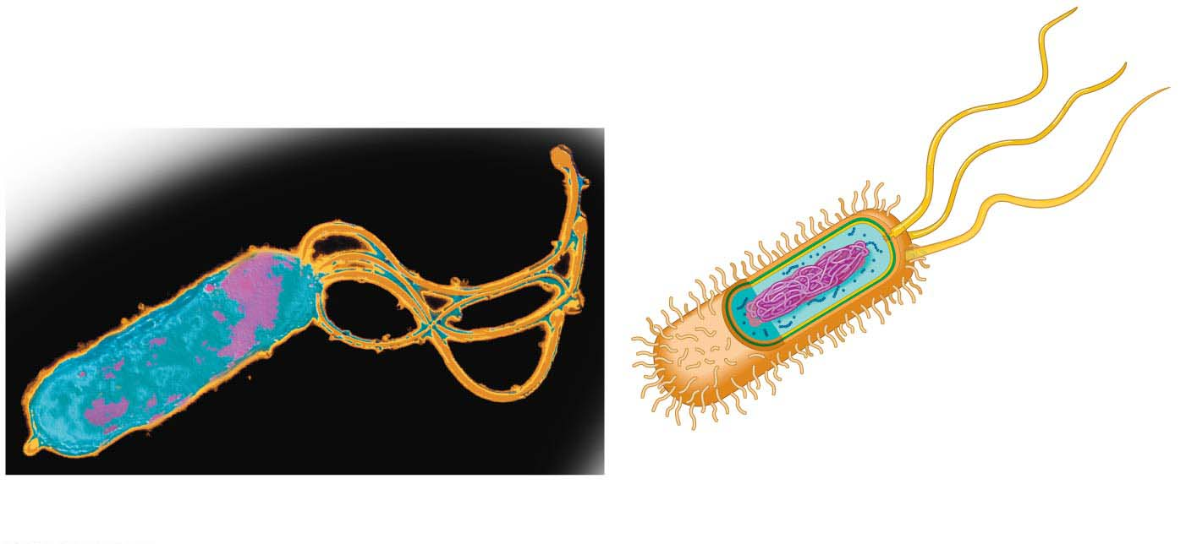
Figure 4.2
A prokaryotic cell lacks a nucleus.
Its DNA is coiled into a nucleus-like region called the nucleoid, which is not partitioned from the rest of the cell by membranes.
Plasma membrane
(encloses cytoplasm)
Cell wall
(provides rigidity)
Capsule
(sticky
coating)
Colorized TEM
Flagella
(for propulsion)
Ribosomes
(synthesize proteins)
Nucleoid (contains
single circular bacterial
chromosome)
Pili (attachment
structures)
Notes:
Figure 4.2 A prokaryotic cell

Slide 5
Surrounding the plasma membrane원형질막 of most prokaryotic cells is a rigid cell wall, which
protects the cell and
helps maintain its shape.
Prokaryotes can have
short projections called pili선모, which can also attach to surfaces, and/or
Flagella편모, long projections that propel them through their liquid environment.
Notes:
5
Student Misconceptions and Concerns
1. Students frequently equate the functions of mitochondria and chloroplasts as alternative ways to acquire usable energy. This often leads to the conclusion that animal cells have mitochondria but not chloroplasts and that plant cells have chloroplasts but not mitochondria. Plant cells have both.
Teaching Tips
1. Even in college, students still struggle with the metric system. When discussing the scale of life, consider bringing a meter stick to class. The ratio of a meter to a millimeter is the same as the ratio of a millimeter to a micron: 1 to 1000.
2. This is a place where a visual image comparing a prokaryotic and eukaryotic cell can be very helpful. These cells are strikingly different in size and composition. A visual reference point instead of just abstract ideas and traits will be a continual reminder for your students during your discussion of these cells.
3. Students might wrongly conclude that prokaryotes are typically one-tenth the volume of eukaryotic cells. A difference in diameter by a factor of ten translates into a much greater difference in volume. Students might be challenged to recall enough geometry to calculate the difference in the volume of two cells with diameters that differ by a factor of ten.
4. Some instructors have reported great success by challenging their students to make analogies to the functions of the many organelles discussed. Students may wish to construct one inclusive analogy between a society or factory (used in the text) and a cell or to construct separate analogies for each organelle. As with any analogy, it is important to list the similarities and differences/exceptions.
5. This might be a good time to discuss the evolution of antibiotic resistance. Teaching tips and ideas for related lessons can be found at www.pbs.org/wgbh/evolution/educators/lessons/lesson6/act1.html.
Active Lecture Tips
1. Germs—here is a term that we learn early in our lives but that is rarely well defined. Ask students to work in pairs to illustrate examples of “germs.” Students may appreciate a biological explanation. The general use of germs is a reference to anything microscopic that causes disease. This may be a good time to sort the major disease-causing agents into three categories: (a) bacteria (prokaryotes), (b) viruses (not yet addressed), and (c) single-celled and multicellular eukaryotes (athlete’s foot is a fungal infection; malaria is caused by a unicellular eukaryote).

Slide 6
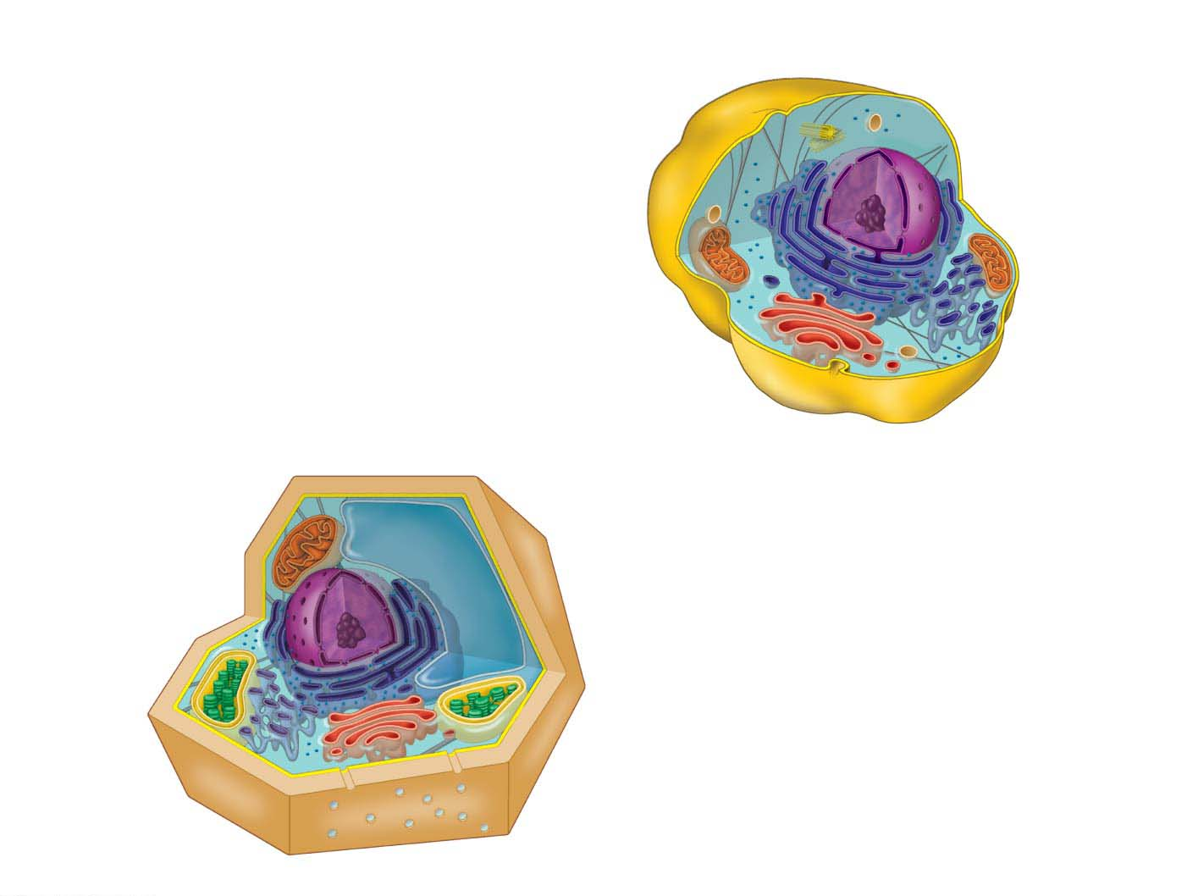
Figure 4.3
IDEALIZED ANIMAL CELL
Ribosomes
Centriole
Not in most
plant cells
Lysosome
Cytoskeleton
Plasma
membrane
Eukaryotic Cells
Cytoplasm
Nucleus
Mitochondrion
Rough
endoplasmic
reticulum (ER)
Smooth
endoplasmic
reticulum (ER)
IDEALIZED PLANT CELL
Golgi
Cytoplasm
apparatus
Cytoskeleton
Mitochondrion
Central vacuole
Not in
Nucleus
Cell wall
animal cells
Rough
endoplasmic
reticulum (ER)
Chloroplast
Ribosomes
Plasma
membrane
Smooth
endoplasmic
reticulum (ER)
Channels between cells
Golgi apparatus
Notes:
Figure 4.3 An idealized animal cell and plant cell

Slide 7
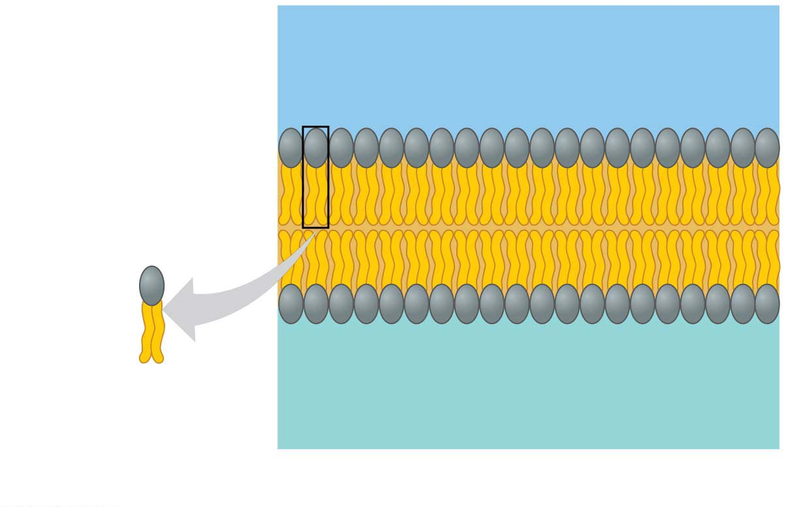
Figure 4.4-1
The Plasma Membrane원형질막
Outside of cell
Hydrophilic
head
Hydrophobic
tail
Phospholipid
Cytoplasm (inside of cell)
(a) Phospholipid인지질 bilayer of membrane
Notes:
Figure 4.4-1 The plasma membrane structure (part 1: phospholipid bilayer)

Slide 8
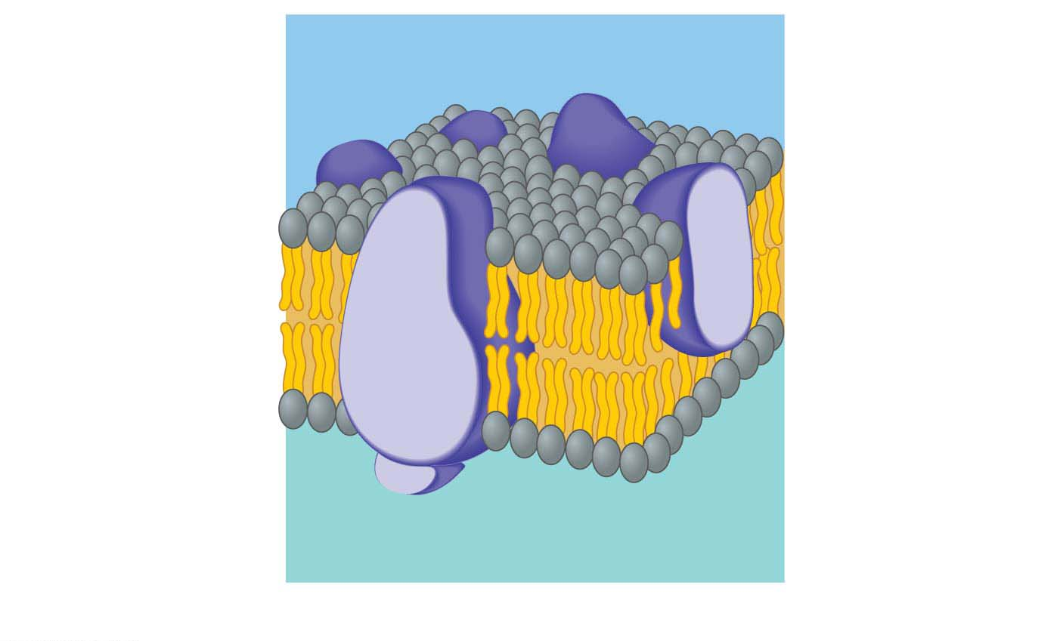
Figure 4.4-2
Embedded
proteins
Outside of cell
Phospholipid
bilayer
Hydrophilic
head
Hydrophobic
tail
Cytoplasm (inside of cell)
(b) Fluid mosaic model of membrane
Notes:
Figure 4.4-2 The plasma membrane structure (part 2: fluid mosaic model)

Slide 9
Plant cells have a cell wall made from cellulose fibers.
protect the cells,
maintain cell shape, and
keep cells from absorbing too much water.
Animal cells
lack cell walls and
most secrete a sticky coat called the extracellular matrix 세포외기질, fibers made of the protein collagen
hold cells together in tissues and
can have protective and supportive functions.
In addition, the surfaces of most animal cells contain cell junctions, structures that connect cells together into tissues, allowing the cells to function in a coordinated way.
Notes:
9
Student Misconceptions and Concerns
1. Students often think of the function of cell membranes as mainly containment, like that of a plastic bag. Consider relating the functions of membranes to our human skin. For example, membranes and our skin (a) detect stimuli, (b) engage in gas exchange, and (c) serve as sites of excretion and absorption.
Teaching Tips
1. The hydrophobic and hydrophilic ends of a phospholipid molecule naturally create a lipid bilayer. The hydrophobic edges of the layer will seal to other such edges, eventually wrapping a sheet into a sphere that can enclose water (a simple cell). Further, because of these hydrophobic properties, lipid bilayers are naturally self-healing. That all of this organization naturally emerges from the properties of phospholipids is worth sharing with your students.
2. You might wish to share a very simple analogy that seems to work with some students. A cell membrane is a little like a peanut butter and jelly sandwich with jellybeans poked into it. The bread represents the hydrophilic portions of the bilayer (and bread does indeed quickly absorb water). The peanut butter and jelly represent the hydrophobic regions (and peanut butter, containing plenty of oil, is generally hydrophobic). The jellybeans stuck into the sandwich represent proteins variously embedded partially into or completely through the membrane. Transport proteins would be like the jellybeans that poke completely through the sandwich. Analogies are rarely perfect. Challenge your students to critique this analogy to find exceptions. (For example, this analogy does not include a model of the carbohydrates on the cell surface.)
Active Lecture Tips
1. See the Activity Peanut Butter Sandwich: Cell Membrane on the Instructor Exchange. Visit the Instructor Exchange in the MasteringBiology instructor resource area for a description of this activity.

Slide 10
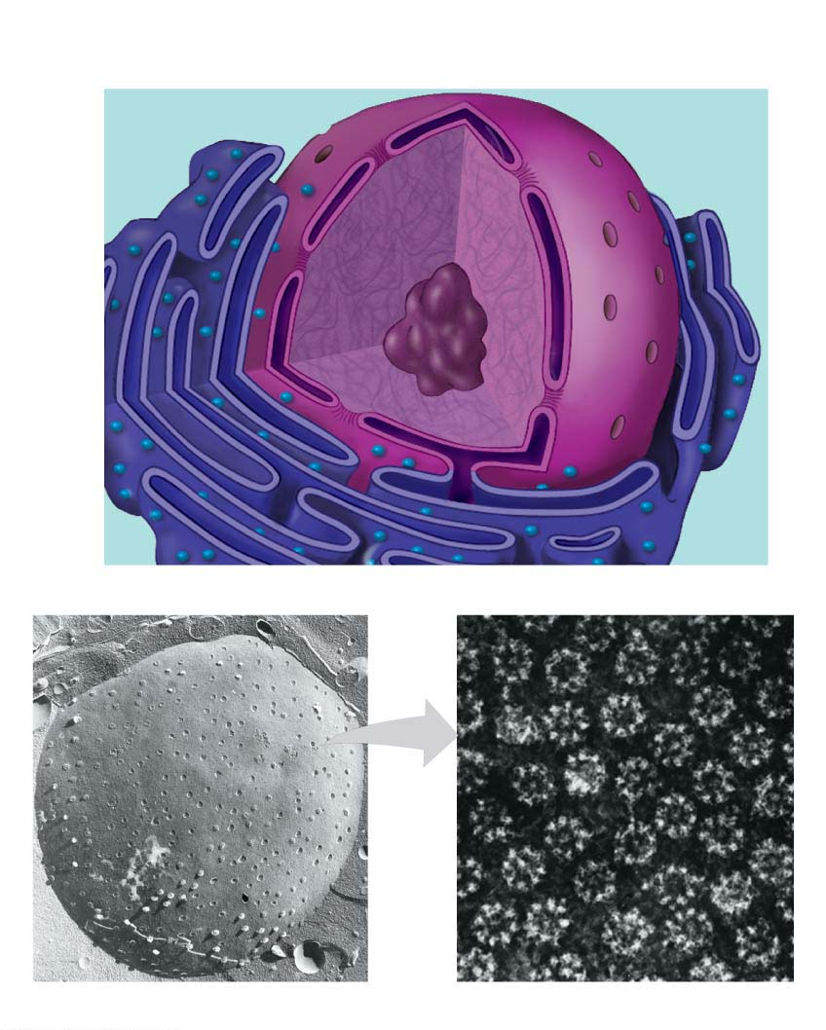
Figure 4.6
Nuclear
envelope
Nucleolus인
Nuclear
Pore핵공
Chromatin염색질
fiber
Nucleus핵
TEM
TEM
Surface of nuclear envelope
Nuclear pores
Notes:
Figure 4.6 The nucleus

Slide 11
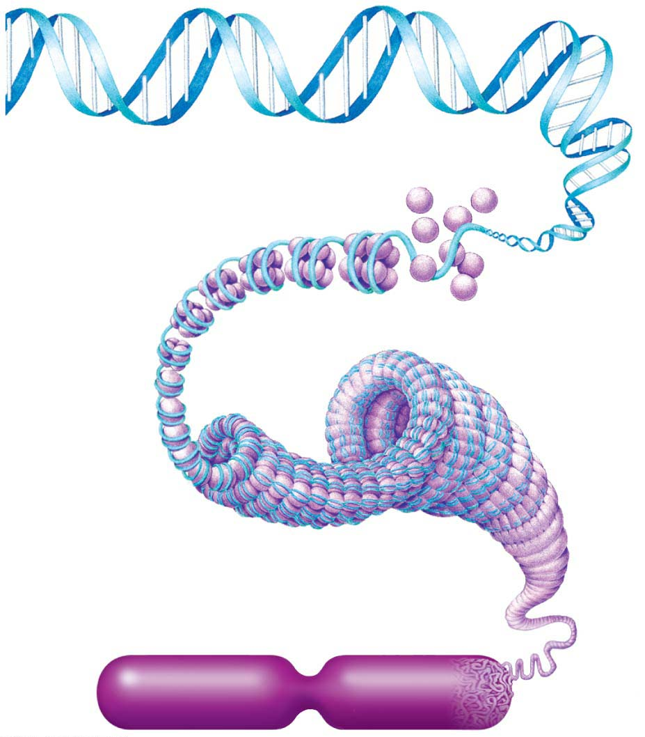
Figure 4.7
DNA molecule
Proteins
Chromatin염색질
fiber
Chromosome염색체
Notes:
Figure 4.7 The relationship between DNA, chromatin, and a chromosome

Slide 12
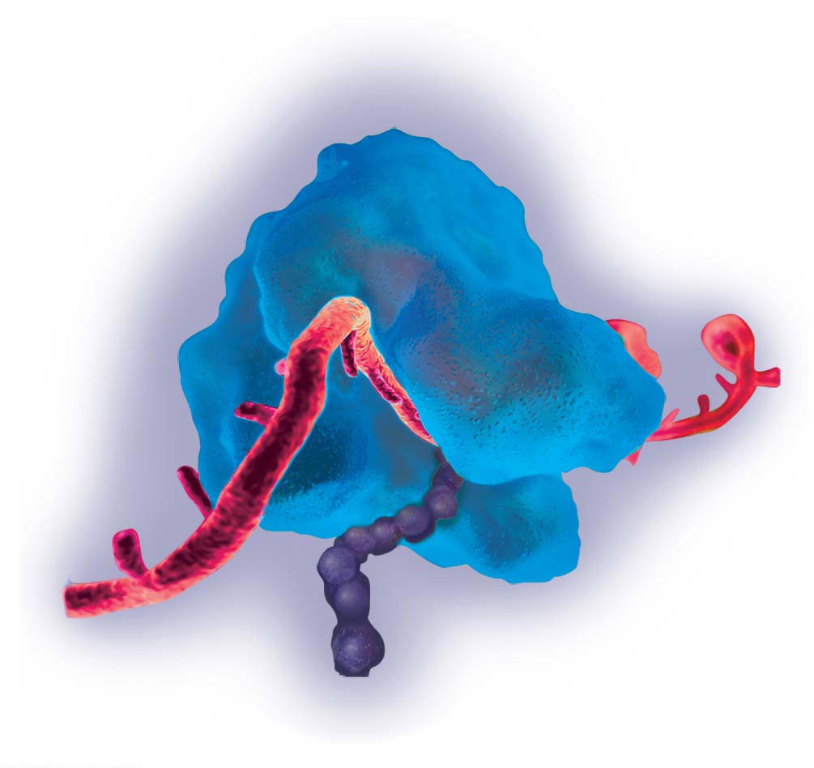
Figure 4.8
Ribosomes
Ribosome
mRNA
Protein
Notes:
Figure 4.8 A computer model of a ribosome in the process of synthesizing a protein

Slide 13
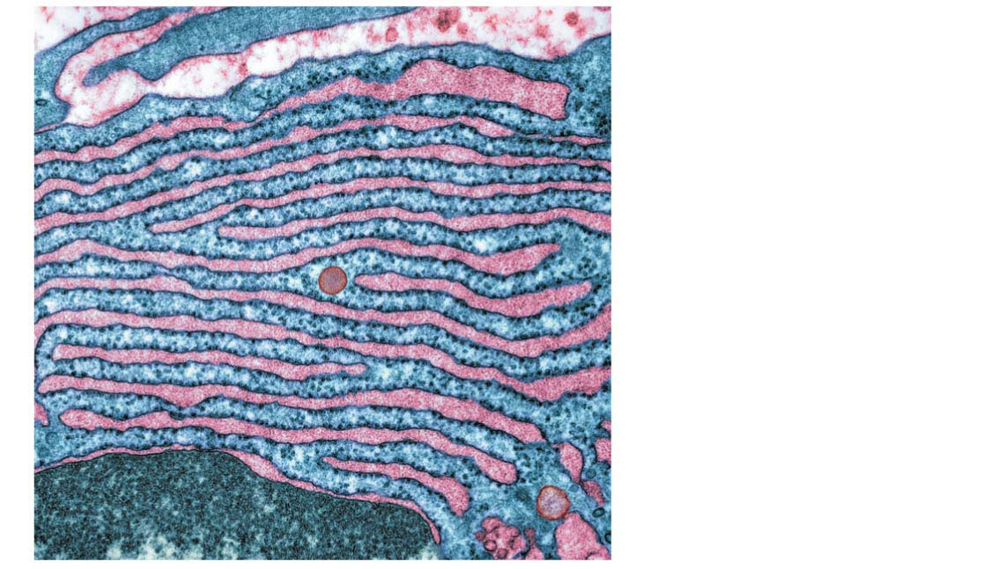
Figure 4.9
Although structurally identical, some ribosomes are suspended in the cytosol, making proteins that remain within the fluid of the cell.
Others are attached to the outside of the nucleus or an organelle called the endoplasmic reticulum, making proteins that are incorporated into membranes or secreted by the cell.
Ribosomes attached
to endoplasmic
reticulum visible as
tiny dark blue dots
TEM
Notes:
Figure 4.9 ER-bound ribosomes

Slide 14
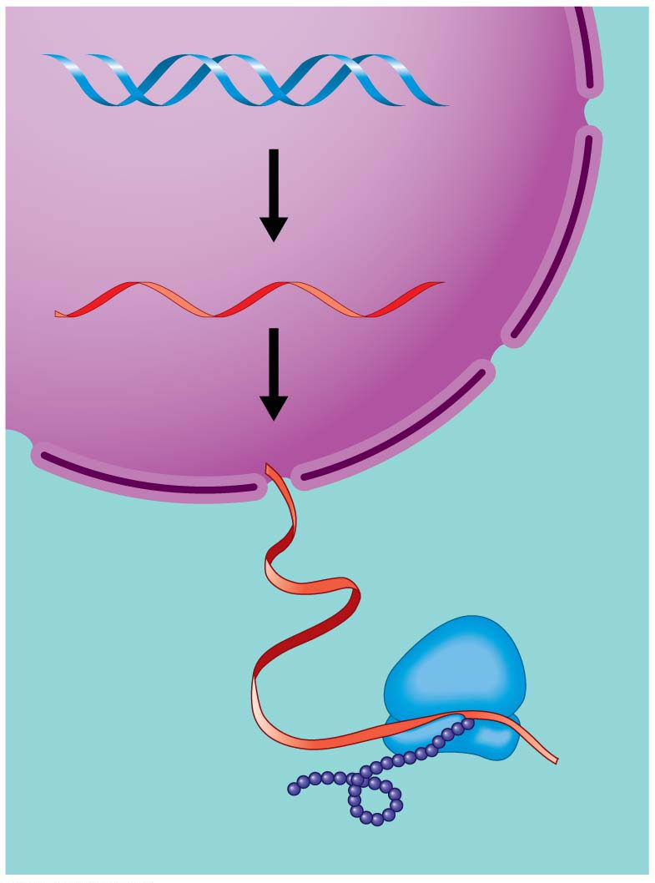
Figure 4.10-s3
DNA
Synthesis of
mRNA in the
nucleus
mRNA
How DNA Directs Protein Production
Nucleus
Cytoplasm
Movement of
mRNA into
cytoplasm via
nuclear pore
mRNA
Ribosome
Synthesis of
protein in the
cytoplasm
Protein
Notes:
Figure 4.10-s3 DNA → RNA → protein (step 3)

Slide 15
The Endomembrane System: Manufacturing and Distributing Cellular Products
The endomembrane system세포내막계 in a cell consists of
the nuclear envelope,
the endoplasmic reticulum,
the Golgi apparatus,
lysosomes, and
vacuoles.
Notes:
15
Student Misconceptions and Concerns
1. Students might have trouble connecting the diverse functions to the organelles. The pathway of secretory proteins is a good process to use to introduce the primary organelle functions. The movement of information and products extends generally from the central nucleus to the interconnected rough ER, to the more peripherally located Golgi, and finally to the outer plasma membrane. Introducing the steps of this process with the central to peripheral flow may help students better see the interrelationships and recall the sequence.
2. Conceptually, some students seem to benefit from the well-developed factory-like-a-cell analogy developed in the text. The use of this analogy in lecture might help to anchor these relationships.
Teaching Tips
1. The endoplasmic reticulum is continuous with the outer nuclear membrane. This explains why the ER is usually found close to the nucleus.
2. Students often learn that a human body can build up a tolerance to a drug. Here in Chapter 4, students learn about one of the specific mechanisms of this response. Liver cells exposed to certain toxins or drugs increase the amount of smooth ER, which functions in the processing of these chemicals. Thus, there is a structural and functional explanation to the development of drug tolerance.
3. Some people think the Golgi apparatus looks like a stack of pita bread.
4. If you continue the factory analogy, the addition of a molecular tag is like adding address labels in the shipping department of a factory.
5. Lysosomes help to recycle damaged cell components. Challenge your students to explain why this is adaptive. Recycling, whether in human society or in our cells, can be an efficient way to reuse materials. The recycled components, which enter the lysosomes in a highly organized form, would require a much greater investment to produce from “scratch.”

Slide 16
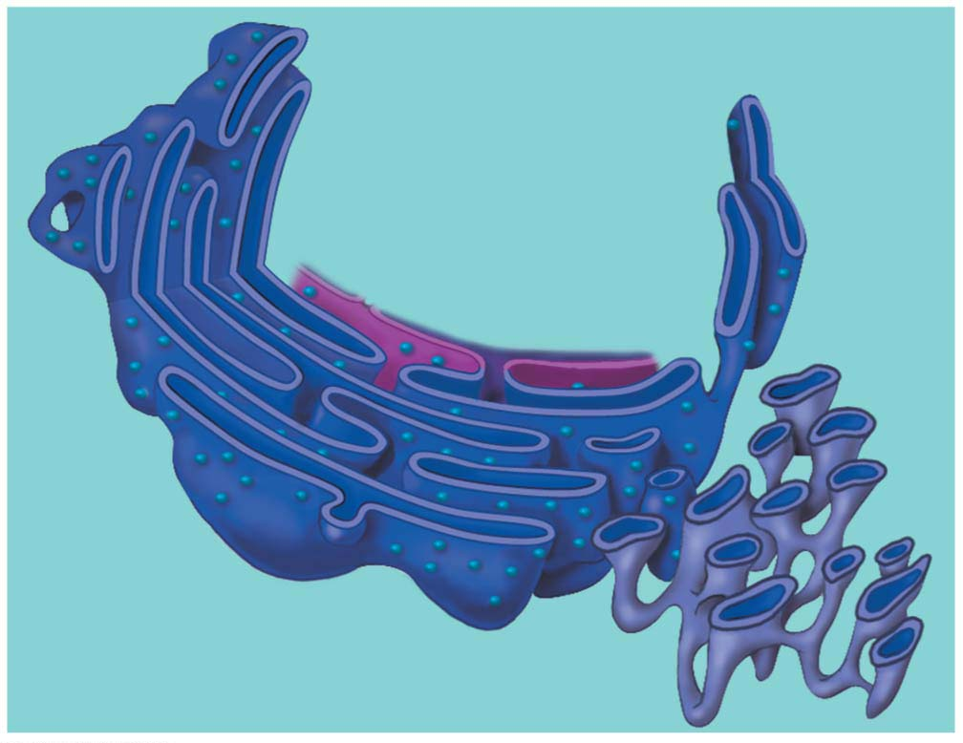
Figure 4.11
Endoplasmic Reticulum소포체
produces an enormous variety of molecules
Nuclear
envelope
Ribosomes
Rough ER
Smooth ER
Notes:
Figure 4.11 The endoplasmic reticulum (ER)

Slide 17
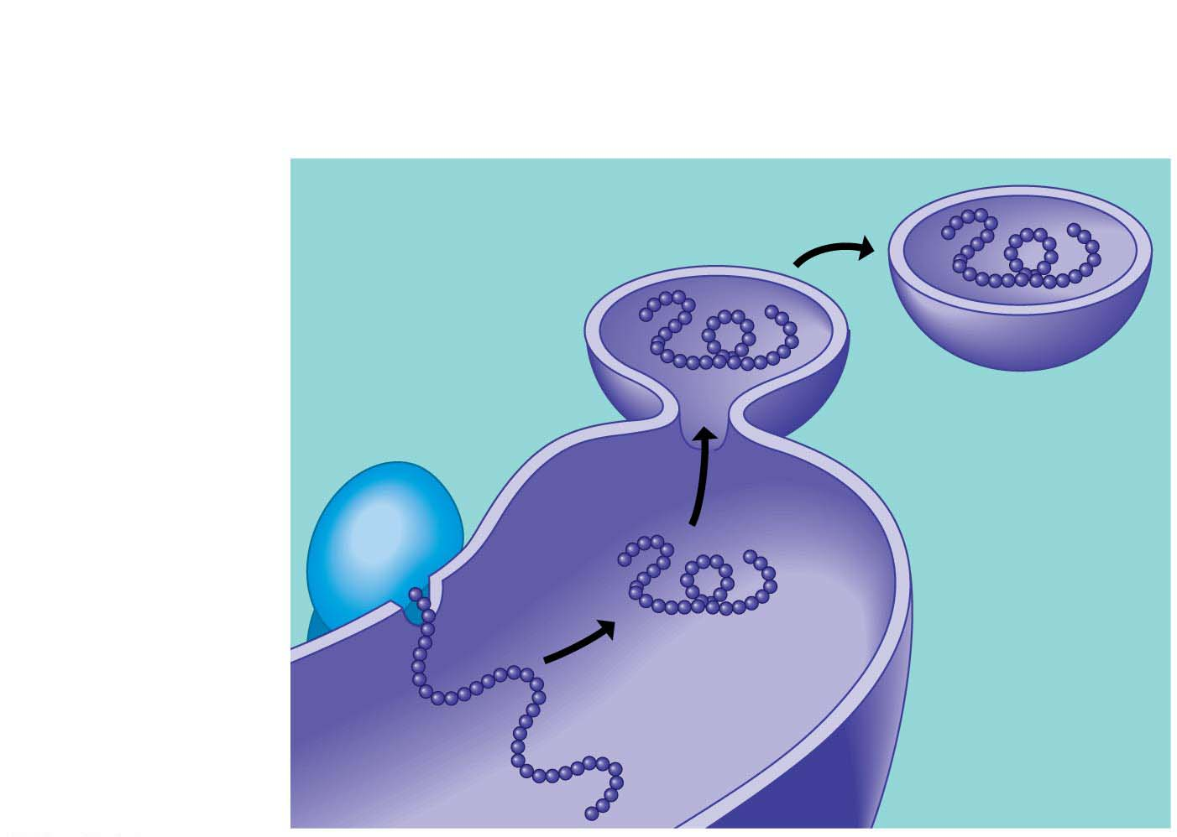
Figure 4.12
Some products manufactured by rough ER are chemically modified and then packaged into transport vesicles, sacs made of membrane that bud off from the rough ER.
4
Vesicles bud off
from the ER
3
Secretory
proteins depart
2
Proteins are
modified in
the ER.
Ribosome
Transport
vesicle
1
A ribosome
links amino
acids.
Protein
Rough ER
Polypeptide
Notes:
Figure 4.12 How rough ER manufactures and packages secretory proteins

Slide 18
The smooth ER
lacks surface ribosomes,
produces lipids, including steroids, and
helps liver cells detoxify circulating drugs.
Notes:
18
Student Misconceptions and Concerns
1. Students might have trouble connecting the diverse functions to the organelles. The pathway of secretory proteins is a good process to use to introduce the primary organelle functions. The movement of information and products extends generally from the central nucleus to the interconnected rough ER, to the more peripherally located Golgi, and finally to the outer plasma membrane. Introducing the steps of this process with the central to peripheral flow may help students better see the interrelationships and recall the sequence.
2. Conceptually, some students seem to benefit from the well-developed factory-like-a-cell analogy developed in the text. The use of this analogy in lecture might help to anchor these relationships.
Teaching Tips
1. The endoplasmic reticulum is continuous with the outer nuclear membrane. This explains why the ER is usually found close to the nucleus.
2. Students often learn that a human body can build up a tolerance to a drug. Here in Chapter 4, students learn about one of the specific mechanisms of this response. Liver cells exposed to certain toxins or drugs increase the amount of smooth ER, which functions in the processing of these chemicals. Thus, there is a structural and functional explanation to the development of drug tolerance.
3. Some people think the Golgi apparatus looks like a stack of pita bread.
4. If you continue the factory analogy, the addition of a molecular tag is like adding address labels in the shipping department of a factory.
5. Lysosomes help to recycle damaged cell components. Challenge your students to explain why this is adaptive. Recycling, whether in human society or in our cells, can be an efficient way to reuse materials. The recycled components, which enter the lysosomes in a highly organized form, would require a much greater investment to produce from “scratch.”

Slide 19
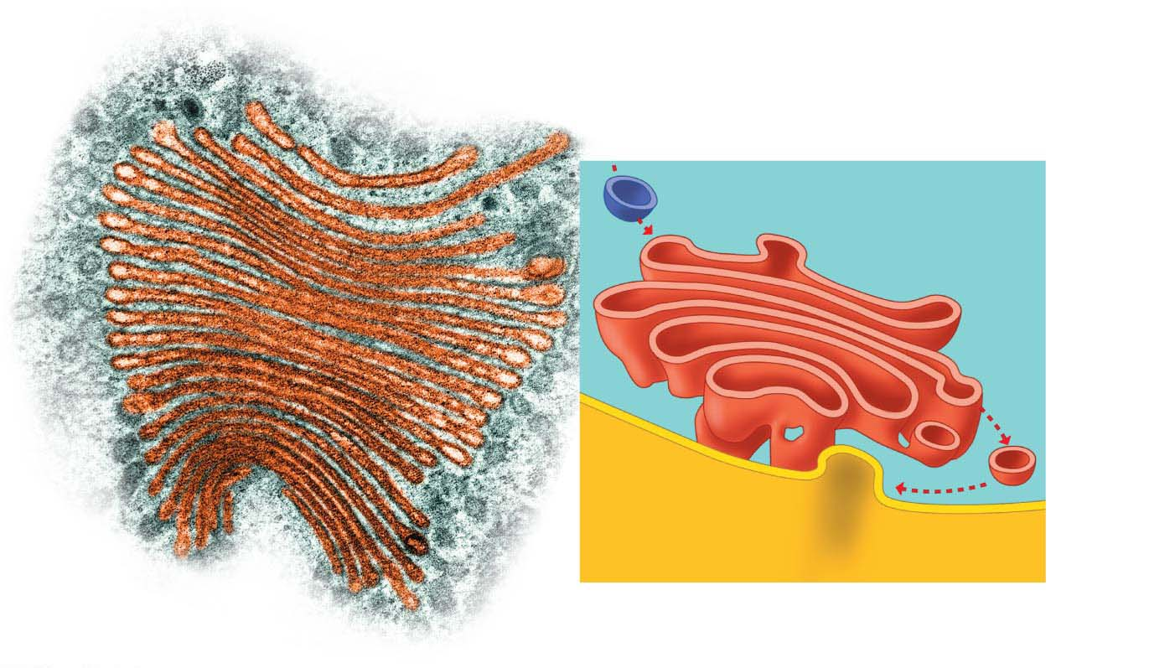
Figure 4.13
The Golgi apparatus골지체 works in partnership with the ER and receives, refines, stores, and distributes chemical products of the cell.
“Receiving” side of the
Golgi apparatus
Transport vesicle
from rough ER
“Receiving” side of
the Golgi apparatus
1
2
New
vesicle
forming
3
Colorized SEM
Transport
vesicle
from the
Golgi
apparatus
New vesicle forming
“Shipping” side of
the Golgi apparatus
Plasma
membrane
Notes:
Figure 4.13 The Golgi apparatus

Slide 20
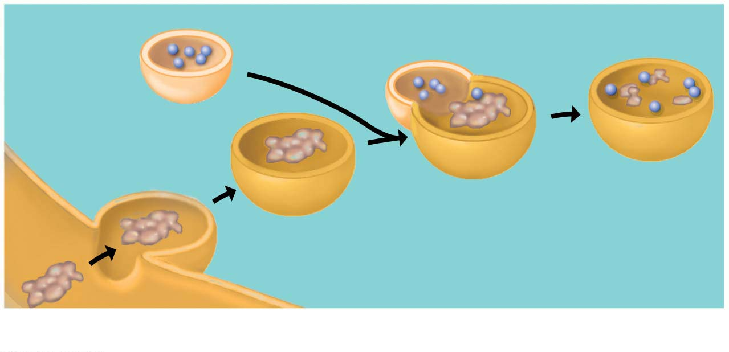
Figure 4.14-1
Lysosomes
A lysosome is a membrane-enclosed sac of digestive enzymes found in animal cells.
Enzymes in a lysosome can break down large molecules such as proteins, polysaccharides, fats, and nucleic acids.
Digestive enzymes
Lysosome
Digestion
Food vacuole
Plasma membrane
(a) A lysosome digesting food
Notes:
Figure 4.14-1 Two functions of lysosomes (part 1: digesting food)

Slide 21
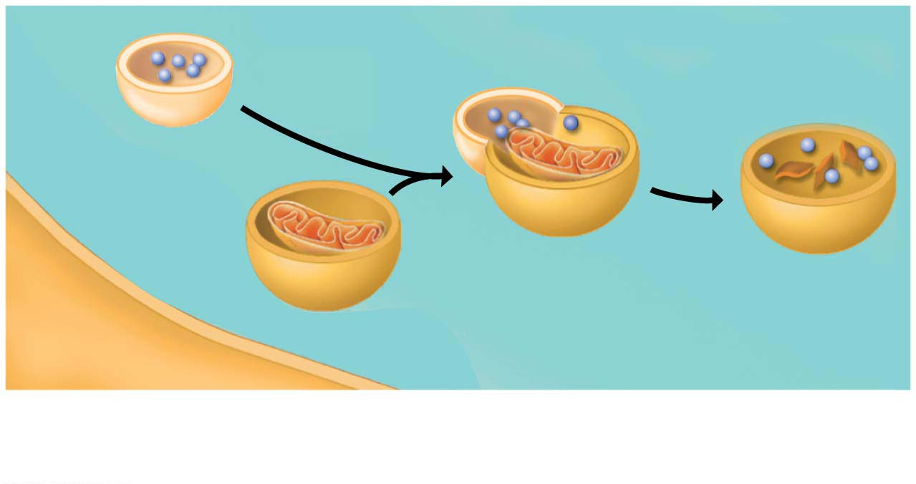
Figure 4.14-2
Lysosomes can also destroy harmful bacteria,
engulf and digest parts of another organelle, and
sculpt tissues during embryonic development, helping to form structures such as fingers.
Lysosome
Vesicle containing
damaged organelle
Digestion
(b) A lysosome breaking down the molecules of damaged organelles
Notes:
Figure 4.14-2 Two functions of lysosomes (part 2: breaking down damaged organelles)

Slide 22
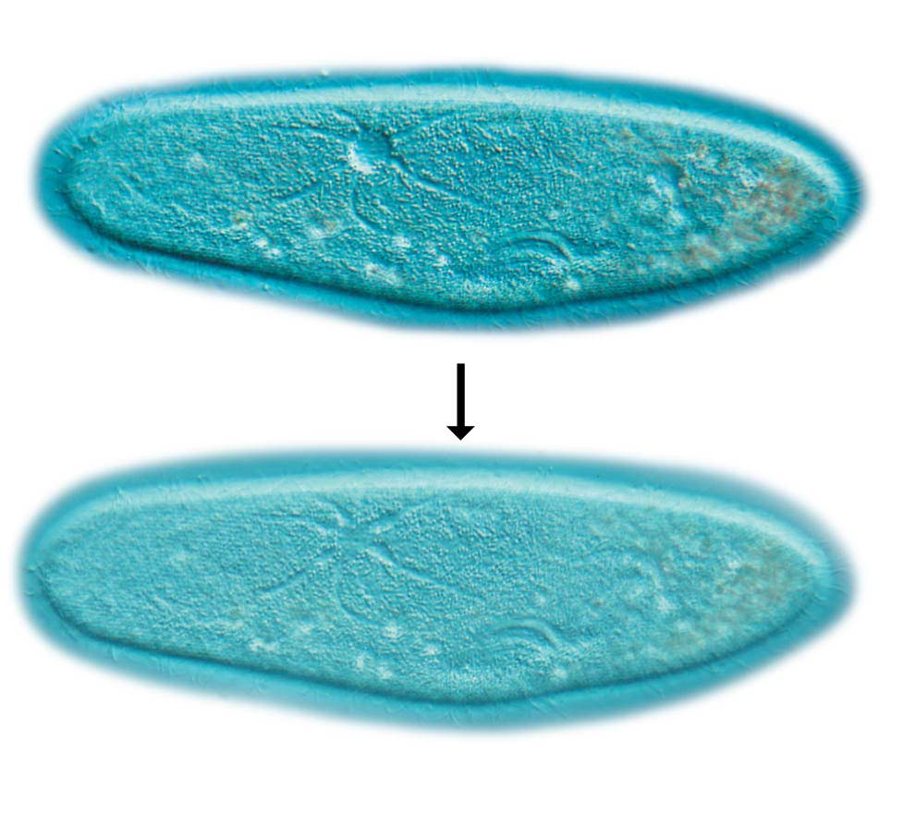
Figure 4.15-1
Vacuoles액포
Vacuoles are large sacs made of membrane that bud off from the ER or Golgi apparatus.
Vacuoles have a variety of functions. For example,
food vacuoles bud from the plasma membrane and
certain freshwater protists원생생물 have contractile vacuoles that pump out excess water that flows into the cell from the outside environment.
A vacuole filling with water
LM
A vacuole contracting
(a) Contractile vacuole in Paramecium
LM
Notes:
Figure 4.15-1 Two types of vacuoles (part 1: contractile)

Slide 23
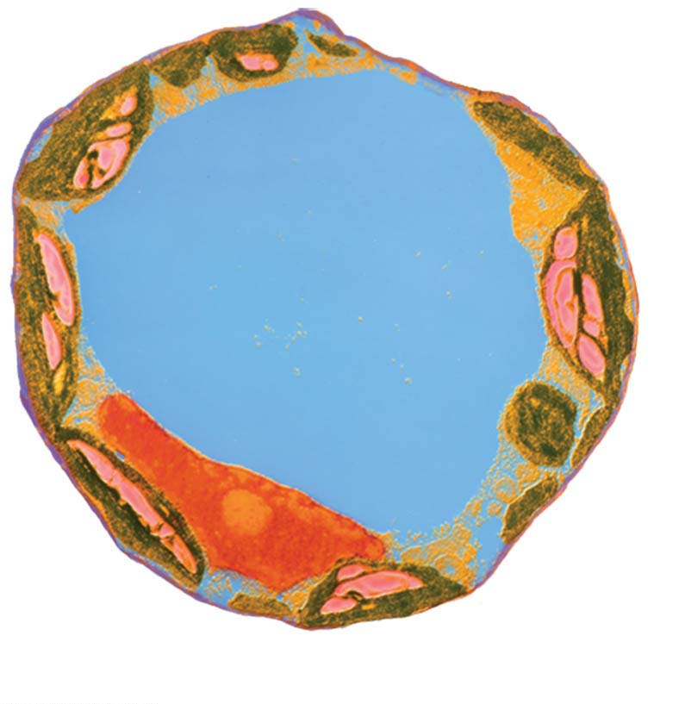
Figure 4.15-2
A central vacuole중앙액포 can account for more than half the volume of a mature plant cell.
The central vacuole of a plant cell is a versatile compartment that may store organic nutrients,
absorb water, and contain pigments that attract pollinating insects or poisons that protect against plant-eating animals.
Colorized TEM
Central vacuole
(b) Central vacuole in a plant cell
Notes:
Figure 4.15-2 Two types of vacuoles (part 2: central)

Slide 24
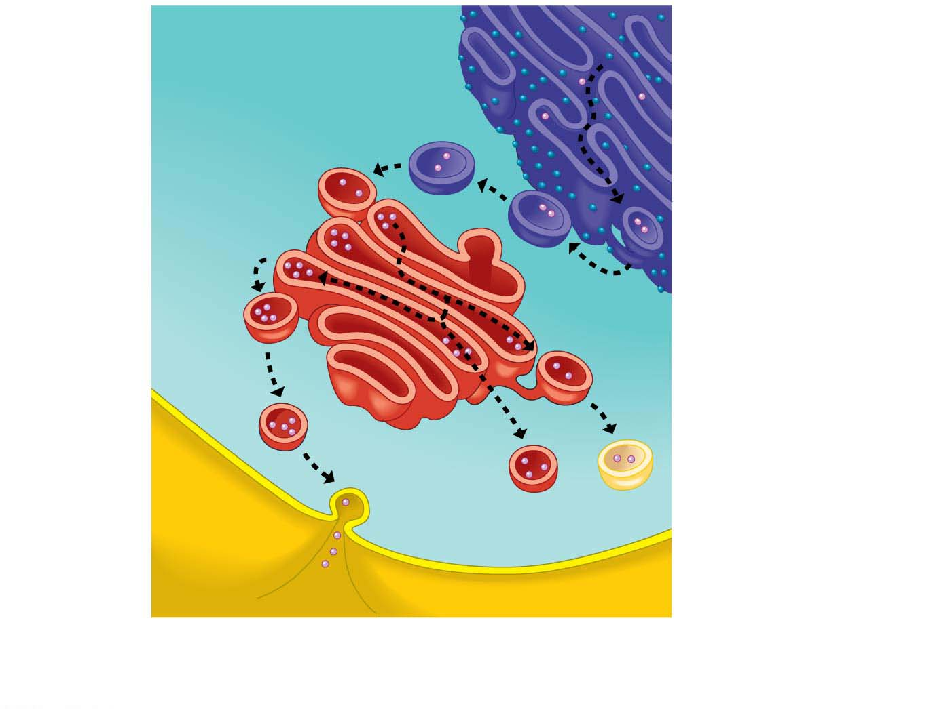
Figure 4.16
Rough ER
Golgi
apparatus
Transport
vesicle
Transport vesicles
carry enzymes and
other proteins from
the rough ER to the
Golgi for processing.
Plasma
membrane
Lysosomes carrying
digestive enzymes
can fuse with other
vesicles.
Secretory
protein
Some products are
secreted from the cell.
Vacuoles store some
cell products.
Notes:
Figure 4.16 Review of the endomembrane system

Slide 25
Energy Transformations: Chloroplasts and Mitochondria
A cell converts energy obtained from the environment to forms that the cell can use directly.
Two organelles act as cellular power stations:
chloroplasts and
mitochondria.
Chloroplast and mitochondrion
contains a single circular DNA chromosome that resembles a prokaryotic chromosome and
can grow and pinch in two, reproducing themselves.
Notes:
25
Student Misconceptions and Concerns
1. Students often mistakenly think that chloroplasts are a substitute for mitochondria in plant cells. They may falsely think that cells either have mitochondria or have chloroplasts. You might challenge this thinking by asking how plant cells generate ATP at night.
2. The evidence that mitochondria and chloroplasts evolved from free-living prokaryotes is further supported by the small size of these organelles, similar to the size of a prokaryote. Mitochondria and chloroplasts are therefore helpful in comparing the general size of eukaryotic and prokaryotic cells. You might think of these organelles as built-in comparisons.
Teaching Tips
1. ATP functions in cells much like money functions in modern societies. Each holds value that can be generated in one place and “spent” in another. This analogy has been very helpful for many students.
2. Mitochondria and chloroplasts are each wrapped by multiple membranes. In both organelles, the innermost membranes are the sites of greatest molecular activity and the outer membranes have fewer significant functions. This makes sense when we consider that the outer membranes correspond to the plasma membrane of the eukaryotic cells that originally wrapped the free-living prokaryotes during endocytosis. Biology makes sense in light of evolution.
3. Mitochondria and chloroplasts are not cellular structures that are synthesized in a cell like ribosomes and lysosomes. Instead, mitochondria only come from other mitochondria and chloroplasts only come from other chloroplasts. This is further evidence of the independent evolution of these organelles from free-living ancestral forms.
Active Lecture Tips
1. See the Activity A Chance Discovery of Endosymbiosis? A Case Study on the Instructor Exchange. Visit the Instructor Exchange in the MasteringBiology instructor resource area for a description of this activity.
2. See the Activity Energy Conversion and iPods on the Instructor Exchange. Visit the Instructor Exchange in the MasteringBiology instructor resource area for a description of this activity.
3. See the Activity Phone Batteries and Cellular Energy on the Instructor Exchange. Visit the Instructor Exchange in the MasteringBiology instructor resource area for a description of this activity.

Slide 26
Chloroplasts
Most of the living world runs on the energy provided by photosynthesis.
Photosynthesis is the conversion of light energy from the sun to
the chemical energy of sugar and
other organic molecules.
Chloroplasts are
unique to the photosynthetic cells of plants and algae and
the organelles that perform photosynthesis.
Notes:
26
Student Misconceptions and Concerns
1. Students often mistakenly think that chloroplasts are a substitute for mitochondria in plant cells. They may falsely think that cells either have mitochondria or have chloroplasts. You might challenge this thinking by asking how plant cells generate ATP at night.
2. The evidence that mitochondria and chloroplasts evolved from free-living prokaryotes is further supported by the small size of these organelles, similar to the size of a prokaryote. Mitochondria and chloroplasts are therefore helpful in comparing the general size of eukaryotic and prokaryotic cells. You might think of these organelles as built-in comparisons.
Teaching Tips
1. ATP functions in cells much like money functions in modern societies. Each holds value that can be generated in one place and “spent” in another. This analogy has been very helpful for many students.
2. Mitochondria and chloroplasts are each wrapped by multiple membranes. In both organelles, the innermost membranes are the sites of greatest molecular activity and the outer membranes have fewer significant functions. This makes sense when we consider that the outer membranes correspond to the plasma membrane of the eukaryotic cells that originally wrapped the free-living prokaryotes during endocytosis. Biology makes sense in light of evolution.
3. Mitochondria and chloroplasts are not cellular structures that are synthesized in a cell like ribosomes and lysosomes. Instead, mitochondria only come from other mitochondria and chloroplasts only come from other chloroplasts. This is further evidence of the independent evolution of these organelles from free-living ancestral forms.
Active Lecture Tips
1. See the Activity A Chance Discovery of Endosymbiosis? A Case Study on the Instructor Exchange. Visit the Instructor Exchange in the MasteringBiology instructor resource area for a description of this activity.
2. See the Activity Energy Conversion and iPods on the Instructor Exchange. Visit the Instructor Exchange in the MasteringBiology instructor resource area for a description of this activity.
3. See the Activity Phone Batteries and Cellular Energy on the Instructor Exchange. Visit the Instructor Exchange in the MasteringBiology instructor resource area for a description of this activity.

Slide 27
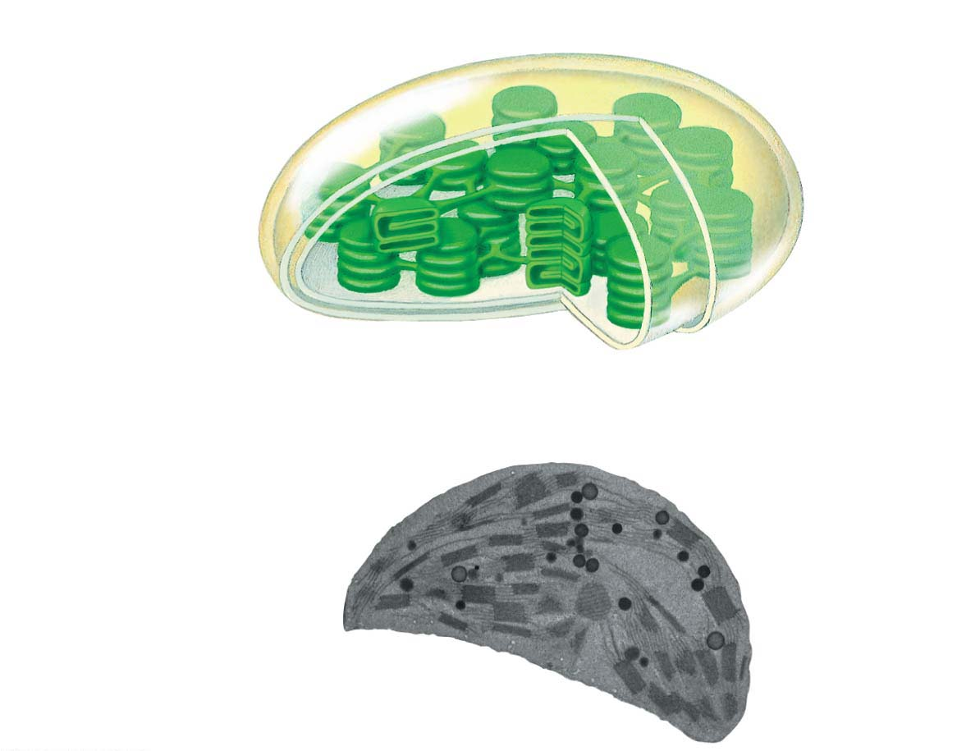
Figure 4.17
Inner and outer
membranes
Space between
membranes
Stroma (fluid in
chloroplast)
Granum
Chloroplast
TEM
Notes:
Figure 4.17 The chloroplast: site of photosynthesis

Slide 28
Mitochondria
Mitochondria
are found in almost all eukaryotic cells,
are the organelles in which cellular respiration takes place, and
produce ATP from the energy of food molecules.
Cells use molecules of ATP as the direct energy source for most of their work.
Notes:
28
Student Misconceptions and Concerns
1. Students often mistakenly think that chloroplasts are a substitute for mitochondria in plant cells. They may falsely think that cells either have mitochondria or have chloroplasts. You might challenge this thinking by asking how plant cells generate ATP at night.
2. The evidence that mitochondria and chloroplasts evolved from free-living prokaryotes is further supported by the small size of these organelles, similar to the size of a prokaryote. Mitochondria and chloroplasts are therefore helpful in comparing the general size of eukaryotic and prokaryotic cells. You might think of these organelles as built-in comparisons.
Teaching Tips
1. ATP functions in cells much like money functions in modern societies. Each holds value that can be generated in one place and “spent” in another. This analogy has been very helpful for many students.
2. Mitochondria and chloroplasts are each wrapped by multiple membranes. In both organelles, the innermost membranes are the sites of greatest molecular activity and the outer membranes have fewer significant functions. This makes sense when we consider that the outer membranes correspond to the plasma membrane of the eukaryotic cells that originally wrapped the free-living prokaryotes during endocytosis. Biology makes sense in light of evolution.
3. Mitochondria and chloroplasts are not cellular structures that are synthesized in a cell like ribosomes and lysosomes. Instead, mitochondria only come from other mitochondria and chloroplasts only come from other chloroplasts. This is further evidence of the independent evolution of these organelles from free-living ancestral forms.
Active Lecture Tips
1. See the Activity A Chance Discovery of Endosymbiosis? A Case Study on the Instructor Exchange. Visit the Instructor Exchange in the MasteringBiology instructor resource area for a description of this activity.
2. See the Activity Energy Conversion and iPods on the Instructor Exchange. Visit the Instructor Exchange in the MasteringBiology instructor resource area for a description of this activity.
3. See the Activity Phone Batteries and Cellular Energy on the Instructor Exchange. Visit the Instructor Exchange in the MasteringBiology instructor resource area for a description of this activity.

Slide 29
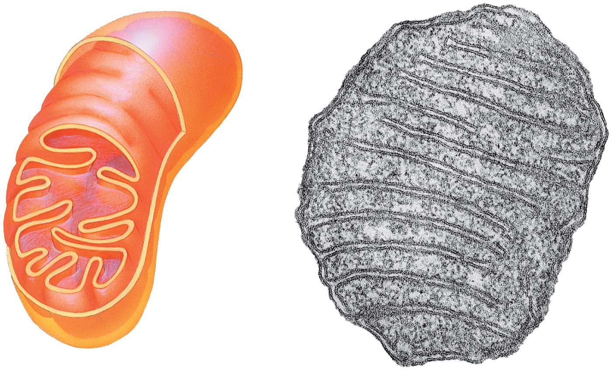
Figure 4.18
Outer
membrane
TEM
Inner
membrane
Cristae
Matrix
Space between
membranes
Notes:
Figure 4.18 The mitochondrion: site of cellular respiration

Slide 30
The Cytoskeleton: Cell Shape and Movement
The cytoskeleton세포골격
is a network of fibers extending throughout the cytoplasm and
serves as both skeleton and “muscles” for the cell, functioning in support and movement. A cell’s cytoskeleton is dynamic.
The cytoskeleton contains several types of fibers made from different proteins.
Microtubules미세소관 are hollow tubes of protein.
The other kinds of cytoskeletal fibers, called intermediate filaments and microfilaments, are thinner and solid.
Notes:
30
Student Misconceptions and Concerns
1. Students often regard the fluid of the cytoplasm as little more than cell broth, a watery fluid that suspends the organelles. The diverse functions of thin, thick, and intermediate filaments are rarely appreciated before college.
2. Students often think that the cilia on the cells lining our trachea function like a comb, removing debris from the air. Except in cases of disease or damage, these respiratory cilia are covered by mucus. Cilia do not reach the air to comb it free of debris. Instead, these cilia sweep dirty mucus up our respiratory tracts to be expelled or swallowed. (See also Active Lecture Tip 1 below.)
3. The dynamic, weblike structure of the cytoskeleton is very different from the skeletons that students may already know. Their dynamic structures (see Teaching Tip 1 below) are quite unlike any human designs. Students have much to gain from vivid illustrations of cytoskeletal diversity. Consider sharing some impressive images from a Google image search or other resources.
Teaching Tips
1. Analogies between the infrastructure of human buildings and the cytoskeleton are limited by the dynamic nature of the cytoskeleton. Few human structures have their structural framework routinely constructed, deconstructed, and then reformed in a new configuration on a regular basis. (Tents are often constructed, deconstructed, and then re-formed repeatedly but typically rely upon the same basic design.) Thus, caution is especially warranted in such analogies.
Active Lecture Tips
1. Students might enjoy this brief class activity. Have everyone in the class clear their throats at the same time. Wait a few seconds. Have them notice that after clearing, they swallowed. The mucus that trapped debris is swept up the trachea by cilia. When we clear our throats, this dirty mucus is disposed of down our esophagus and among the strong acids of our stomach!
2. See the Activity Using Ropes to Demonstrate the Pulling Forces of Actin and Myosin on the Instructor Exchange. Visit the Instructor Exchange in the MasteringBiology instructor resource area for a description of this activity.

Slide 31
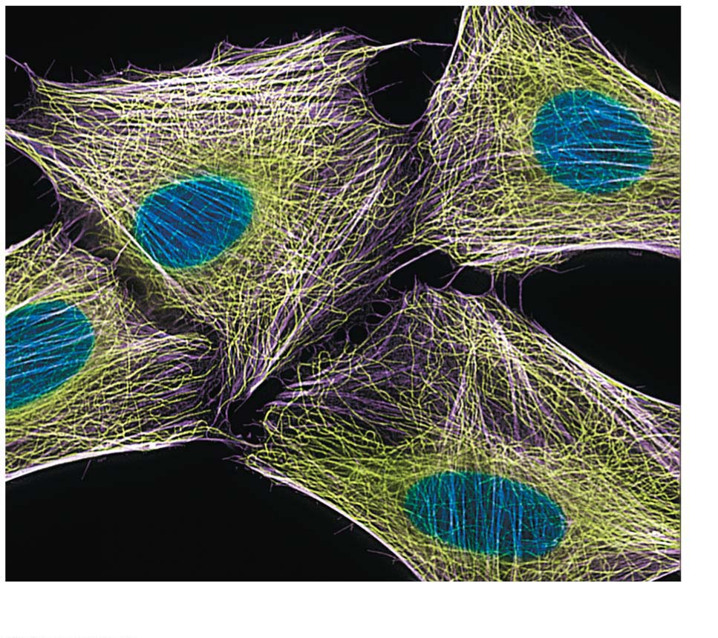
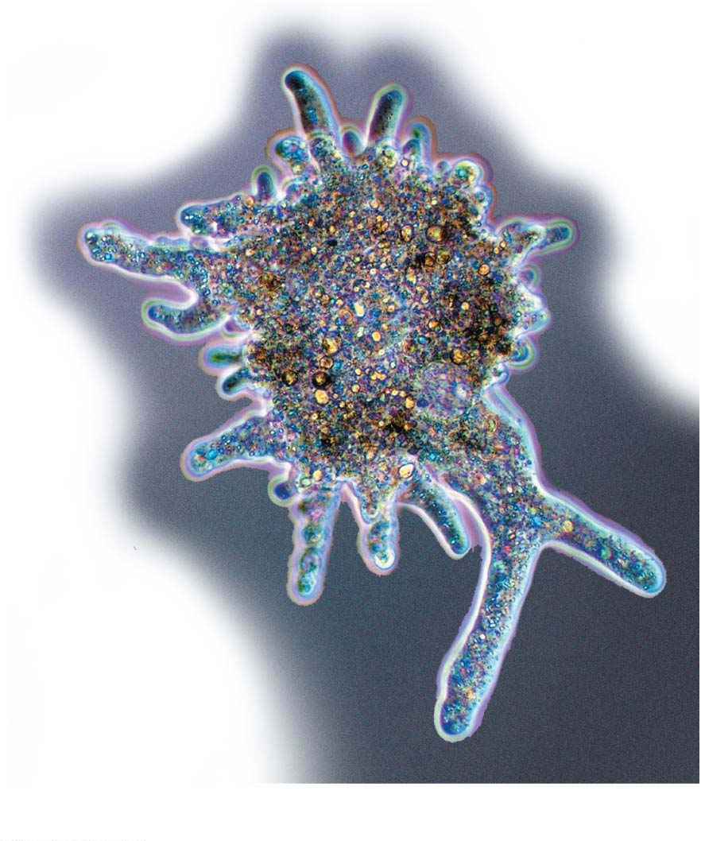
Figure 4.19-1
LM
(a) Microtubules in the cytoskeleton
LM
(b) Microtubules and movement
Notes:
Figure 4.19-1 The cytoskeleton (part 1: microtubules)

Slide 32
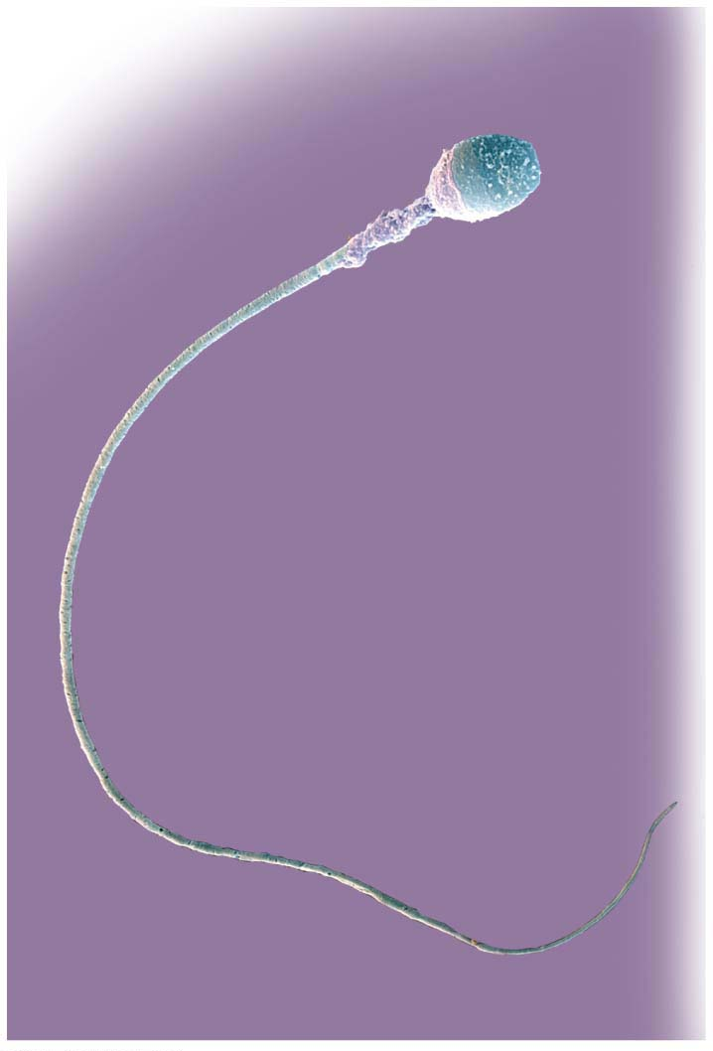
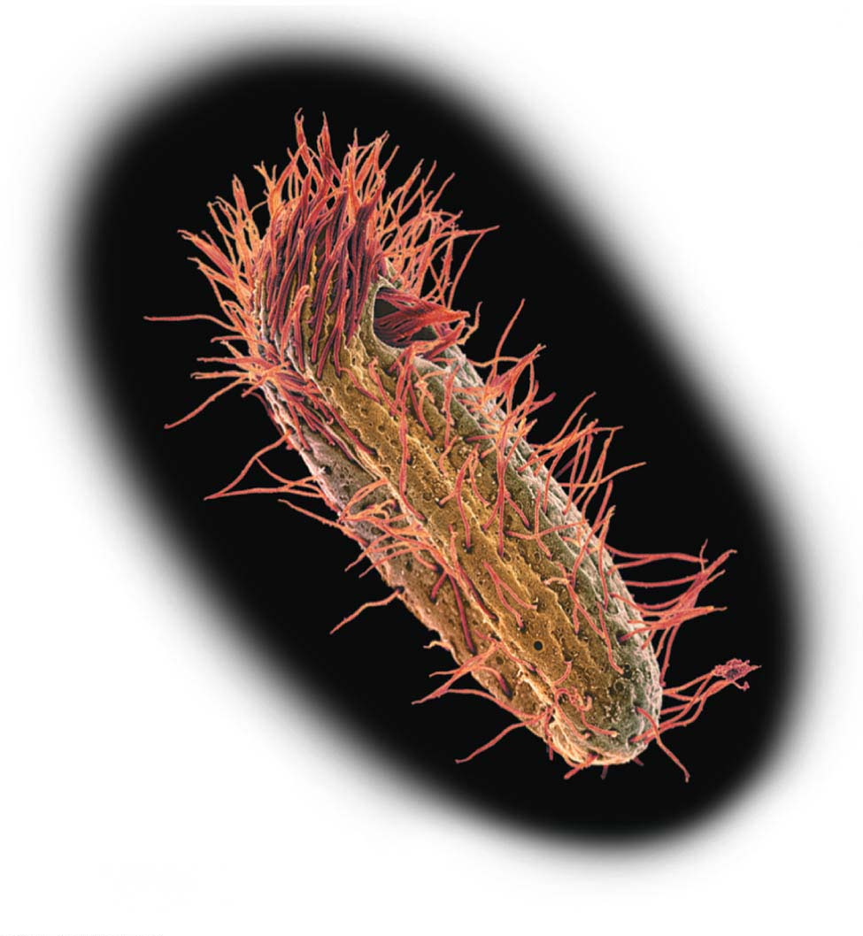
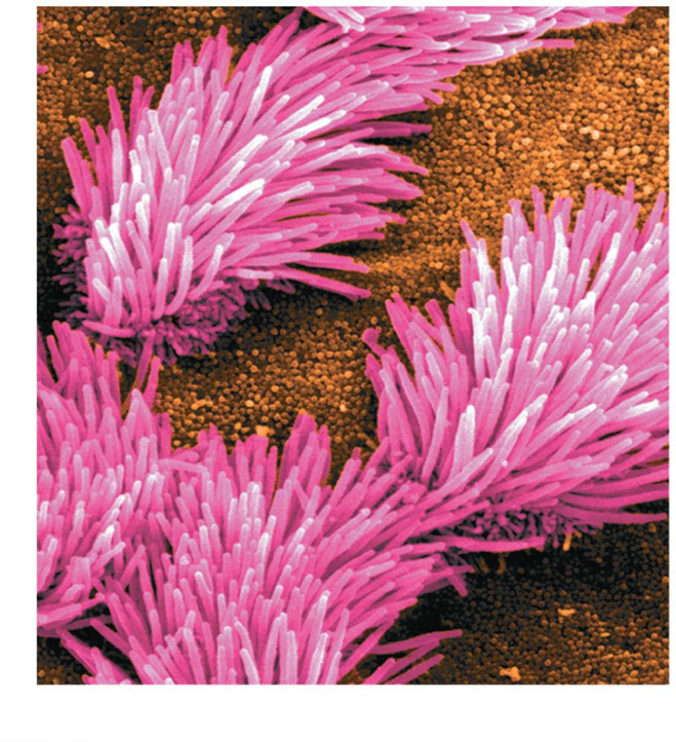
Cilia섬모 and Flagella편모
In some eukaryotic cells, microtubules are arranged into structures called flagella and cilia, extensions from a cell that aid in movement.
Eukaryotic flagella propel cells through an undulating, whiplike motion.
They often occur singly, such as in human sperm cells, but may also appear in groups on the outer surface of protists.
Colorized SEM
(a) Flagellum of a
human sperm cell
(b) Cilia on a protist
(c) Cilia lining the respiratory tract
Notes:
32
Student Misconceptions and Concerns
1. Students often regard the fluid of the cytoplasm as little more than cell broth, a watery fluid that suspends the organelles. The diverse functions of thin, thick, and intermediate filaments are rarely appreciated before college.
2. Students often think that the cilia on the cells lining our trachea function like a comb, removing debris from the air. Except in cases of disease or damage, these respiratory cilia are covered by mucus. Cilia do not reach the air to comb it free of debris. Instead, these cilia sweep dirty mucus up our respiratory tracts to be expelled or swallowed. (See also Active Lecture Tip 1 below.)
3. The dynamic, weblike structure of the cytoskeleton is very different from the skeletons that students may already know. Their dynamic structures (see Teaching Tip 1 below) are quite unlike any human designs. Students have much to gain from vivid illustrations of cytoskeletal diversity. Consider sharing some impressive images from a Google image search or other resources.
Teaching Tips
1. Analogies between the infrastructure of human buildings and the cytoskeleton are limited by the dynamic nature of the cytoskeleton. Few human structures have their structural framework routinely constructed, deconstructed, and then reformed in a new configuration on a regular basis. (Tents are often constructed, deconstructed, and then re-formed repeatedly but typically rely upon the same basic design.) Thus, caution is especially warranted in such analogies.
Active Lecture Tips
1. Students might enjoy this brief class activity. Have everyone in the class clear their throats at the same time. Wait a few seconds. Have them notice that after clearing, they swallowed. The mucus that trapped debris is swept up the trachea by cilia. When we clear our throats, this dirty mucus is disposed of down our esophagus and among the strong acids of our stomach!
2. See the Activity Using Ropes to Demonstrate the Pulling Forces of Actin and Myosin on the Instructor Exchange. Visit the Instructor Exchange in the MasteringBiology instructor resource area for a description of this activity.

